Slide 1
School life
with half a heart
Powered by Little Hearts Matter,
registered charity number 1123290

Slide 2
My Heart
My name is ___, you might not notice but I have a special heart and have had ___ heart operations in my life.
Use this space to tell the audience what having a special heart means for you / your child.
Place your
photo here
Hey! My name is ____

Slide 3
How my heart works
Little Hearts Matter is a charity that offers free information to help people understand how single ventricle heart conditions work…
To learn more, go to
lhm.org.uk/conditions

Slide 4
My heart operations
Use this space to tell the audience more about the operations you / your child has had.
Place your
photo here

Slide 5
Feeling tired
Feeling cold
What my
Heart
Low energy
Missing school
means
Hospital visits
Hard to focus
*Delete me* Use this page to tell people about the challenges you / your child experiences at school.

Slide 6
Think about your school values
How you can help
You can’t see everything, like my special heart!
Come to school with kindness, friendship and an open mind.
Notes:
Please do not edit this slide, thank you.

Slide 7
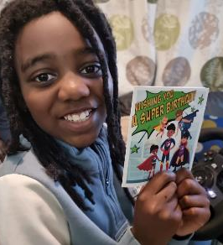
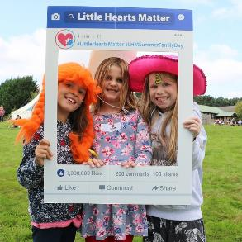
How Little Hearts Matter Helps
LHM helps thousands of people with a special heart
Support
Information
Community
Being there for people with half a heart
Helping people understand their heart condition
Bringing people with half a heart together
Notes:
Please do not edit this slide, thank you.

Slide 8
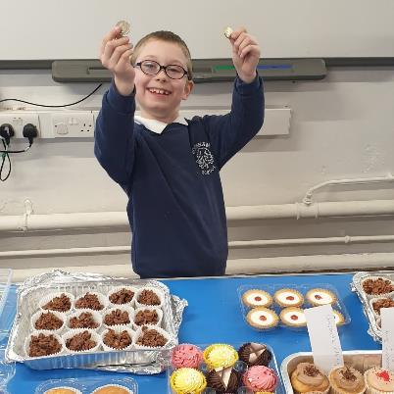
Fundraising
The charity needs money to provide its much-needed services.
For Little Hearts Matter
You could do;
- Dress down days
- Competitions
- Cake sales
- challenges (runs, walks, silences).
Ben raised £130 for LHM at his school!
Notes:
Please do not edit this slide, thank you.

Slide 9
THANK YOU!
Thank you for listening ☺
To fundraise for Little Hearts Matter
go to lhm.org.uk/support-us
Notes:
Please do not edit this slide, thank you.

