Slide 1
Preparation for Primary School
How to get the most out of school when you have half a working heart.

Slide 2
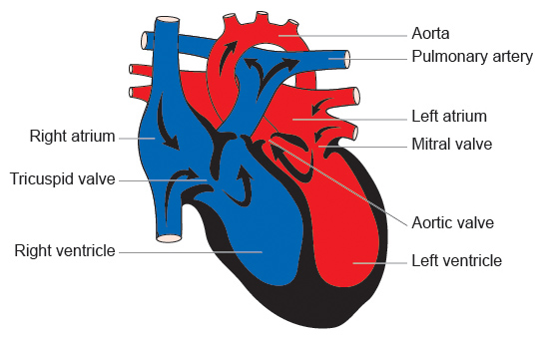
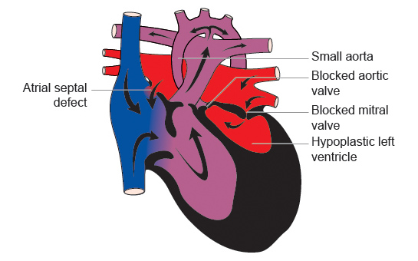
The Normal Heart
Hypoplastic Left Heart Syndrome

Slide 3
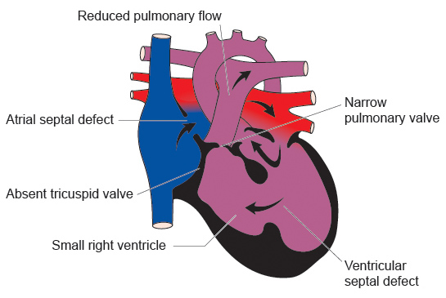
The Normal Heart
Tricuspid Atresia

Slide 4
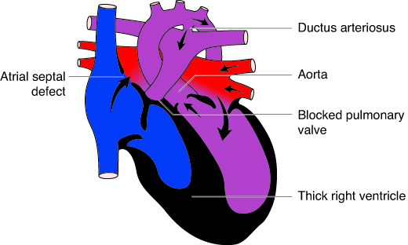
The Normal Heart
Complex Pulmonary Atresia

Slide 5
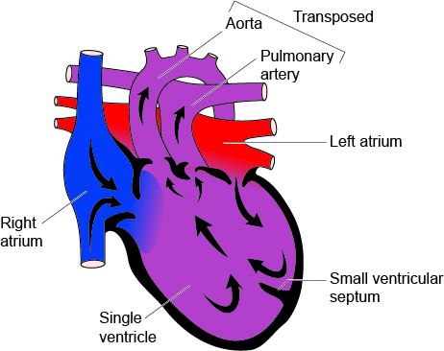
The Normal Heart
Univentricular Heart

Slide 6
My Child
Include information about their number of operations, medications etc.

Slide 7
School life is all about BALANCE

Slide 8
Half a Heart…Half the Energy
Children with a normal heart have 20 spoonfuls of energy to use each day.
Children with half a heart just have 10.

Slide 9
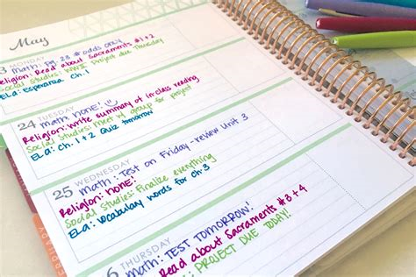
Concentration
Lack of energy.
Lack of sleep.
An educational problem.
Problem areas:
After a physical lesson.
Before food.
End of the day.
End of the week.
Homework.

Slide 10
Healthcare Plans - HCP
All children with a long-term health condition must have a Healthcare Plan (HCP) in place .
This is the law adopted in 2014 as part of the Child and Family Bill.
All education authorities will have their own template for HCP completion.
Specialist nurses from the cardiac unit, in partnership with the school nurse, parents and teachers will complete the form.
Children in secondary school should be included in setting the plan.

Slide 11
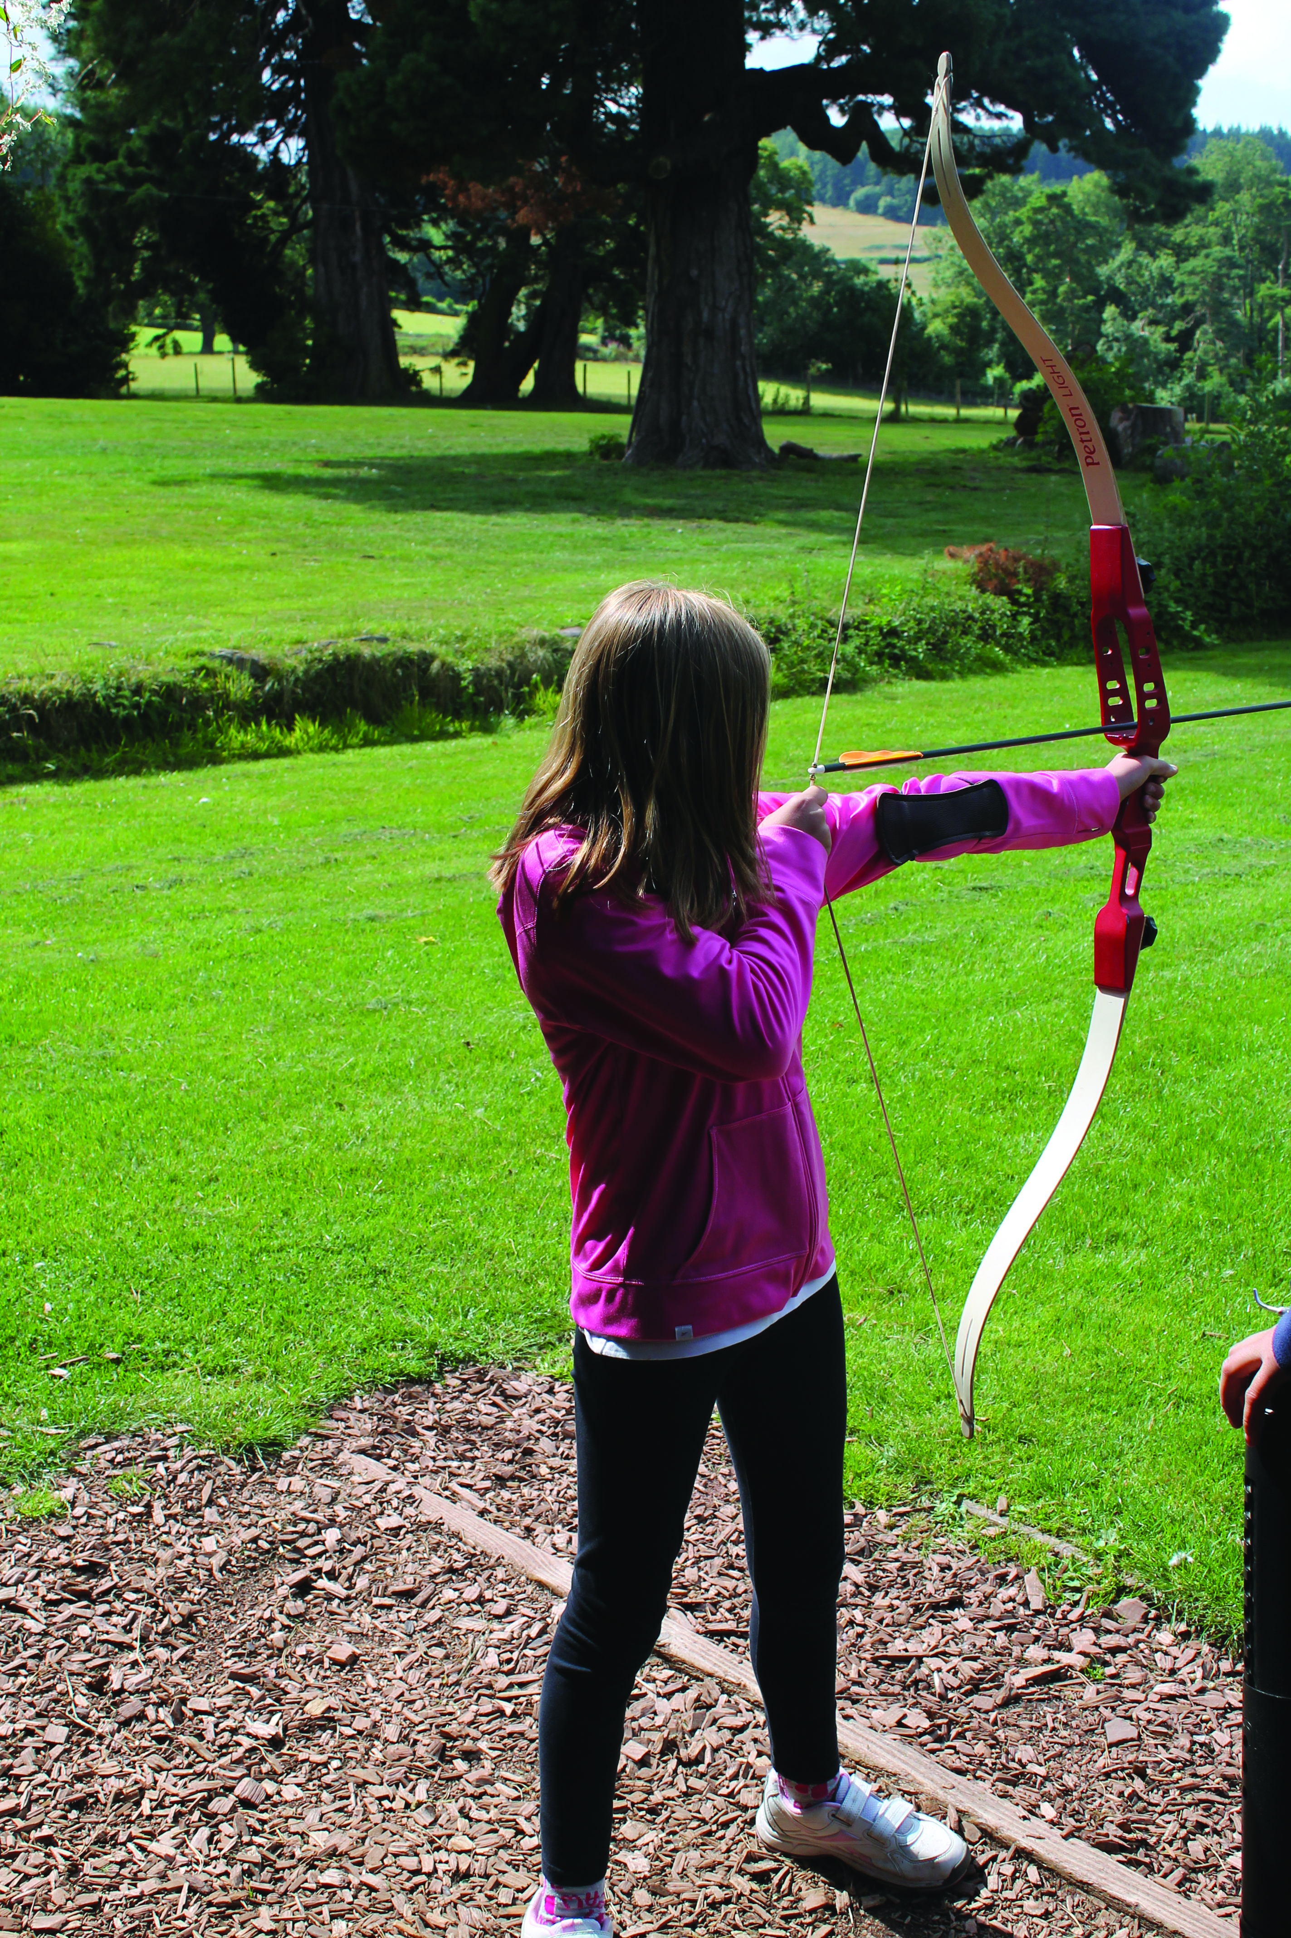
Participation
Sport and exercise – Most children can take a part in PE but care must be taken to ensure that they take part at a safe level.
Remember the GOLDEN RULE Children exercising should be able to have a conversation with their teacher whilst they exercise. If they can not talk they are working too hard.
www.lhm.org.uk/information/lifestyle-information/sports-and-exercise/
Drama, singing, playing an instrument – All these activities can be encouraged with the same safety considerations as set out for sport.
School trips – Children with half a heart can and should be included in school trips and out of school activities. Discussion with parents when planning activities should be encouraged so that full inclusion is possible.

Slide 12
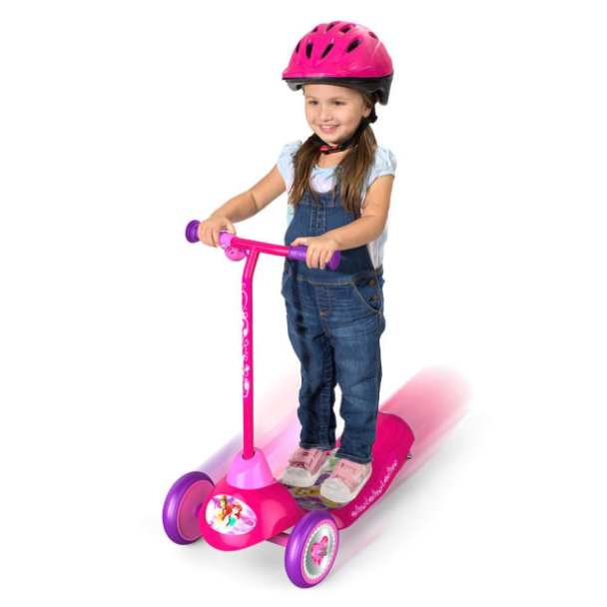
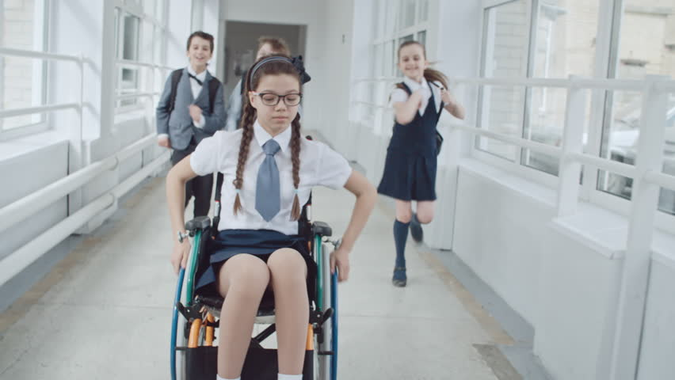
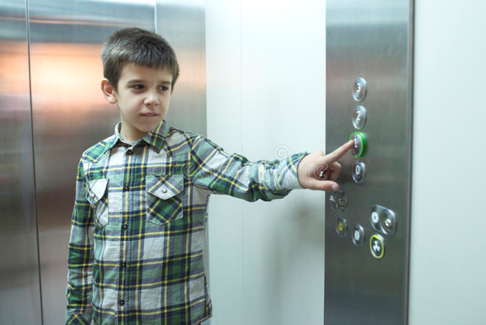
Mobility
Finding support in getting around saves energy for learning.
Electric scooter to get around school.
Help with a wheelchair when children are tired or on a school trip.
Leaving a classroom early to get to the next class.
Using the school lift to avoid the stairs.

Slide 13
Educational Delay
Up to 35% of children with a single ventricle heart have problems with education.
Fine motor control – holding a pencil or doing up buttons or laces.
Gross motor control – riding a bike or balancing on a beam.
Dyslexia
Dyscalculics
Attention Deficit Hyperactivity Disorder (ADHD) – This often confuses teachers as they think they should be tired. The issue for children with half a heart relates to energy and concentration.
The Autistic Spectrum
Should any educational challenges or deficits be noted a full plan for actions to support learning should be created. In some cases an Education and Healthcare Plan (EHCP) will be needed.

Slide 14
Keeping a heart child safe
All information about risks and actions should be in the Healthcare Plan
Heart failure – The heart is failing to do its job properly. The changes are:
Increased breathless.
Increased cyanosis (blue lips and fingers).
Settle the children sitting upright and allow them to catch their breath. If their colour does not settle take the action set out in the Healthcare Plan, HCP.
Infections – Colds, coughs and childhood illness.
Children with half a heart run on half the energy so they pick up infections easily and take longer to recover. Parents will keep them away from school if they are ill or at risk of catching a severe infection.
Risk of bleeding – The children are on Anticoagulation Therapy (Warfarin or Aspirin). If injured they:
Bleed more profusely.
Bruise extensively.
Follow the treatment plan of action set out in their Healthcare Plan. Swift action is needed if the children fall and hit their heads.
Heart stops beating – This is extremely rare.
Normal First Aid resuscitation should be performed.

Slide 15
Keeping a heart child safe continued…
All information about risks and actions should be in the Healthcare Plan
Keeping warm – Children with half a heart have difficulty keeping warm. They need to wrap up warm in cold and wet weather or have indoor play provision available.
Keeping hydrated – Children with half a heart have to drink enough to create a good circulating blood supply otherwise their hearts do not work very well. Drinks must be available throughout the day.
Food – Children with half a working heart need regular boosts of energy by way of healthy snacks. They are often slow eaters so added support may be needed through meal times.
Medications – There may be times when medications need to be taken during the school day. Provision for this should be set out in the Healthcare Plan.
Exhaustion – If a child with half a heart has used up all of their energy for the day before the end of the school day they may need an opportunity to rest. Provision should be made for a safe place to rest should it be required.

Slide 16
Mental health
When you have half a working heart one of the most complex problems is that your disorder is unseen.
People forget about your challenges because they can not see that you have a problem. The fact that you live with half the energy of your peers, have had repeated operations and hospital visits, and that you have a growing understanding that your heart will never be normal is never seen and often not understood.
Children with half a working heart are often:
Depressed.
Bullied.
Suffer with Post Traumatic Stress Disorder.
Lack personal confidence.

Slide 17
Resources
Early Years Foundation Stage (EYFS) and Key Stage 1 booklet.
Key Stage 2 – junior school booklet.
Healthcare Plans for Children and Young People with a Single Ventricle Heart Condition booklet.
Support for a Child with Special Educational Needs within Nursery, School and Further Education booklet.
Sport and exercise booklet.
Living with anticoagulation booklet.
Half a heart…Half the Energy plan.
www.lhm.org.uk

